Slide 1
Task 2: Develop IaC Scripts for Compute Resources (EC2, ECS)

Slide 2
TERRAFORM
Terraform is an open-source infrastructure as code (IaC) software tool which can be used to provision the infrastructure of a cloud platform.
The HCL scripts which have been used to provision infrastructure can be human-readable configuration files that can be versioned, reused, and shared. You can provision wide range of resources in the cloud by using terraform like compute, storage, networking, and application services, across a variety of cloud providers and on-premises environments.

Slide 3
AWS IaC tools
AWS CloudFormation
Terraform
Azure Resource

Slide 4
Benefits of IaC on AWS
Automation: IaC automates infrastructure provisioning, saving time and effort.
Repeatability: IaC ensures consistent infrastructure across environments, leading to reliable deployments.
Version Control: IaC configurations are stored in version control systems like AWS CodeCommit, allowing for tracking changes and rollbacks.
Reduced Errors: IaC eliminates manual errors common in traditional infrastructure management.
Improved Collaboration: IaC fosters collaboration between developers and operations teams by providing a shared infrastructure definition.

Slide 5
Amazon Elastic Container Service (ECS)
Amazon Elastic Container Service (ECS) is a fully managed service that enables users to run Docker-based applications in containers across a cluster of EC2 instances.
ECS simplifies container orchestration, allowing you to deploy, manage, and scale containerized applications efficiently.
The service supports multiple launch types, including the AWS Fargate launch type, which abstracts the underlying EC2 infrastructure, enabling you to run containers without needing to manage or provision the EC2 instances.
This allows developers to focus on building and deploying applications while AWS handles the cluster management and resource provisioning.

Slide 6
Elastic Compute Cloud (EC2)
EC2 stands for Elastic Compute Cloud. EC2 is an on-demand computing service on the AWS cloud platform. Under computing, it includes all the services a computing device can offer to you along with the flexibility of a virtual environment.
It also allows the user to configure their instances as per their requirements i.e. allocate the RAM, ROM, and storage according to the need of the current task. Even the user can dismantle the virtual device once its task is completed and it is no more required.
For providing, all these scalable resources AWS charges some bill amount at the end of every month, the bill amount is entirely dependent on your usage.

Slide 7
AWS EC2 Instance Types
General Purpose Instances
Compute Optimized Instances
Memory-Optimized Instances
Storage Optimized Instances
Accelerated Computing Instances

Slide 8
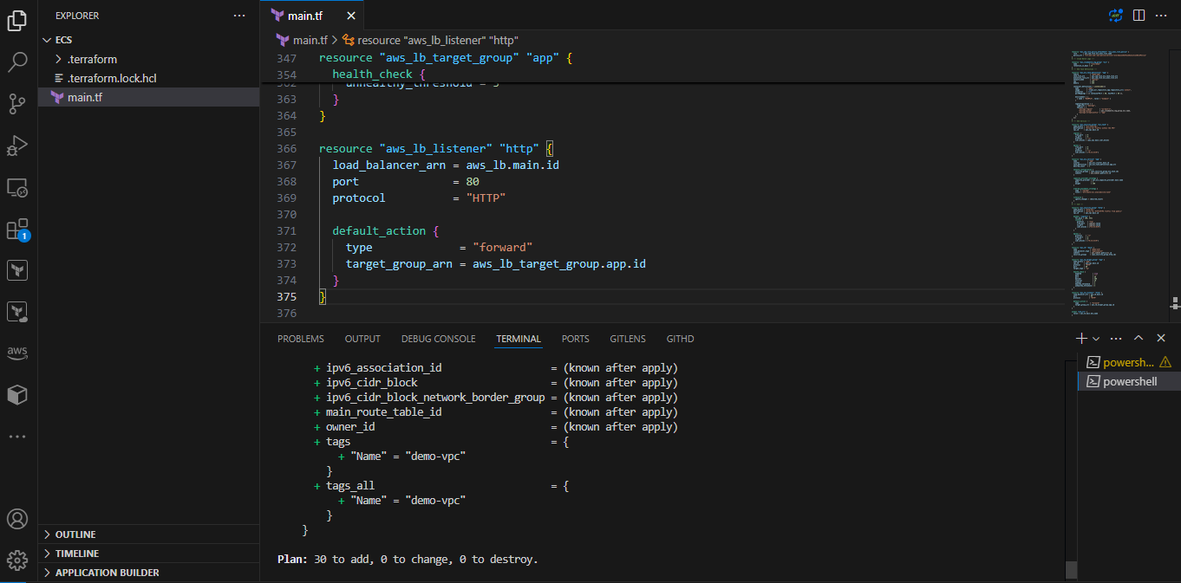
After writing all codes give terraform init, terraform plan and terraform apply while giving terraform apply ec2 ecs cluster has created in aws console

Slide 9
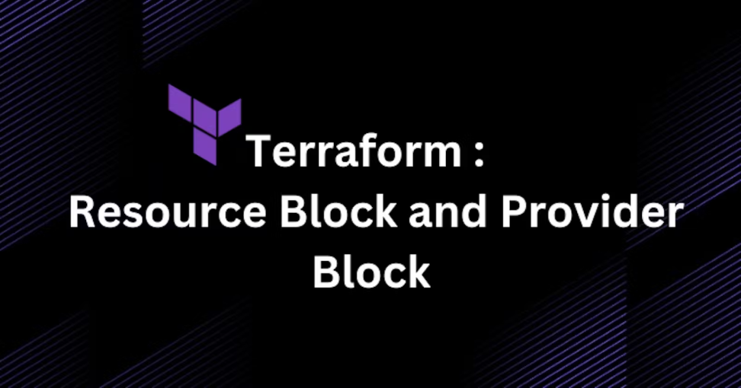
Aws provider
terraform {
required_providers {
aws = { source = "hashicorp/aws", version = "5.17.0" }
}
}
provider "aws" {
profile = "default"
region = "us-east-1"
}

Slide 10
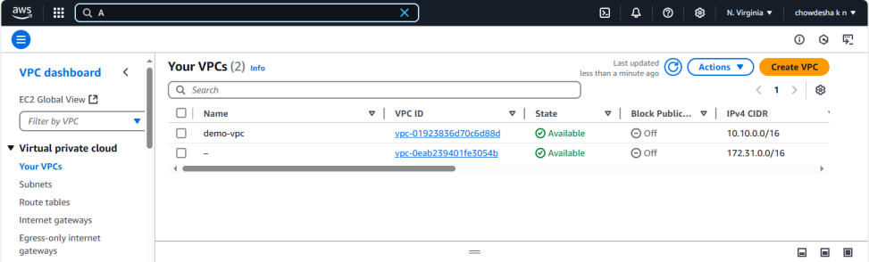
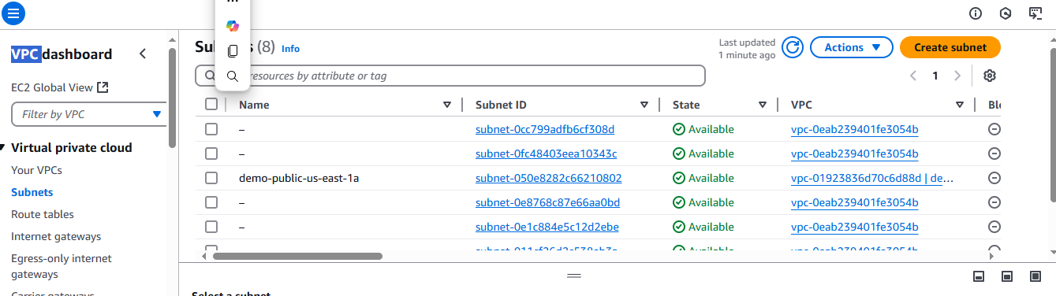
VPC Let’s get started with VPC module creation. It will be necessary for each and every one of our apps’ network connections.
# --- VPC ---
data "aws_availability_zones" "available" { state = "available" }
locals {
azs_count = 2
azs_names = data.aws_availability_zones.available.names
}
resource "aws_vpc" "main" {
cidr_block = "10.10.0.0/16"
enable_dns_hostnames = true
enable_dns_support = true
tags = { Name = "demo-vpc" }
}
resource "aws_subnet" "public" {
count = local.azs_count
vpc_id = aws_vpc.main.id
availability_zone = local.azs_names[count.index]
cidr_block = cidrsubnet(aws_vpc.main.cidr_block, 8, 10 + count.index)
map_public_ip_on_launch = true
tags = { Name = "demo-public-${local.azs_names[count.index]}" }
}

Slide 11
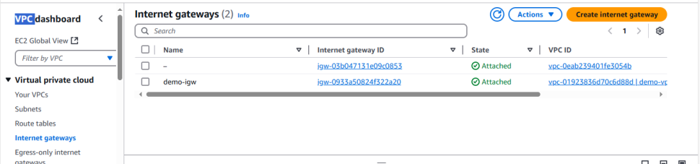
An internet gateway is a horizontally scaled, redundant, and highly available VPC component that allows communication between your VPC and the internet.
# --- Internet Gateway ---
resource "aws_internet_gateway" "main" {
vpc_id = aws_vpc.main.id
tags = { Name = "demo-igw" }
}
resource "aws_eip" "main" {
count = local.azs_count
depends_on = [aws_internet_gateway.main]
tags = { Name = "demo-eip-${local.azs_names[count.index]}" }
}

Slide 12
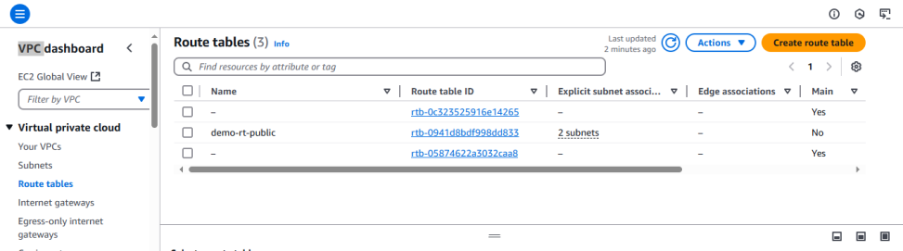
Public route table is created we will see in the aws console
# --- Public Route Table ---
resource "aws_route_table" "public" {
vpc_id = aws_vpc.main.id
tags = { Name = "demo-rt-public" }
route {
cidr_block = "0.0.0.0/0"
gateway_id = aws_internet_gateway.main.id
}
}
resource "aws_route_table_association" "public" {
count = local.azs_count
subnet_id = aws_subnet.public[count.index].id
route_table_id = aws_route_table.public.id
}

Slide 13
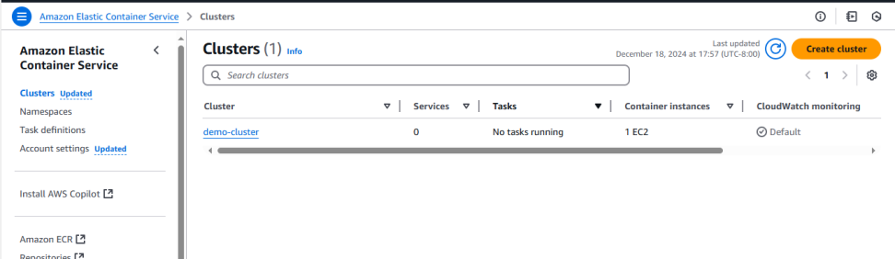
ECS Cluster is created we will see in the aws console
# --- ECS Cluster ---
resource "aws_ecs_cluster" "main" {
name = "demo-cluster"
}

Slide 14
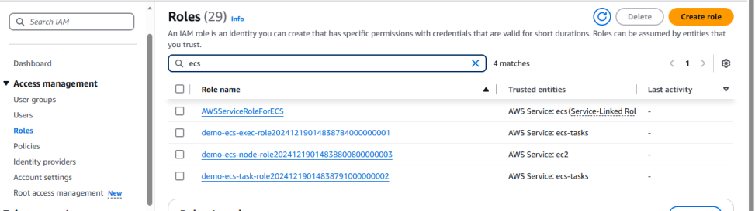
While creating ecs cluster ecs node role is necessary here below see the result of ecs node role
# --- ECS Node Role ---
data "aws_iam_policy_document" "ecs_node_doc" {
statement {
actions = ["sts:AssumeRole"]
effect = "Allow"
principals {
type = "Service"
identifiers = ["ec2.amazonaws.com"]
}
}
}
resource "aws_iam_role" "ecs_node_role" {
name_prefix = "demo-ecs-node-role"
assume_role_policy = data.aws_iam_policy_document.ecs_node_doc.json
}
resource "aws_iam_role_policy_attachment" "ecs_node_role_policy" {
role = aws_iam_role.ecs_node_role.name
policy_arn = "arn:aws:iam::aws:policy/service-role/AmazonEC2ContainerServiceforEC2Role"
}
resource "aws_iam_instance_profile" "ecs_node" {
name_prefix = "demo-ecs-node-profile"
path = "/ecs/instance/"
role = aws_iam_role.ecs_node_role.name
}

Slide 15
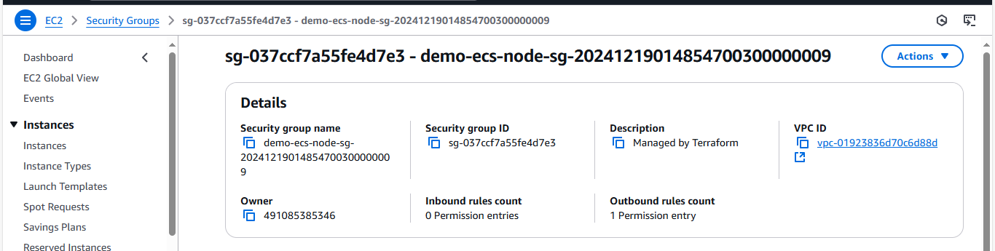
Below is ecs node security group we will see in aws console
# --- ECS Node SG ---
resource "aws_security_group" "ecs_node_sg" {
name_prefix = "demo-ecs-node-sg-"
vpc_id = aws_vpc.main.id
egress {
from_port = 0
to_port = 65535
protocol = "tcp"
cidr_blocks = ["0.0.0.0/0"]
}
}

Slide 16
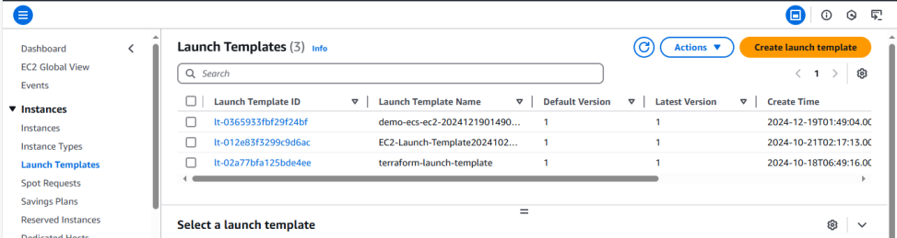
While writing below code Ecs launch template is created.
# --- ECS Launch Template ---
data "aws_ssm_parameter" "ecs_node_ami" {
name = "/aws/service/ecs/optimized-ami/amazon-linux-2/recommended/image_id"
}
resource "aws_launch_template" "ecs_ec2" {
name_prefix = "demo-ecs-ec2-"
image_id = data.aws_ssm_parameter.ecs_node_ami.value
instance_type = "t2.micro"
vpc_security_group_ids = [aws_security_group.ecs_node_sg.id]
iam_instance_profile { arn = aws_iam_instance_profile.ecs_node.arn }
monitoring { enabled = true }
user_data = base64encode(<<-EOF
#!/bin/bash
echo ECS_CLUSTER=${aws_ecs_cluster.main.name} >> /etc/ecs/ecs.config;
EOF
)
}

Slide 17
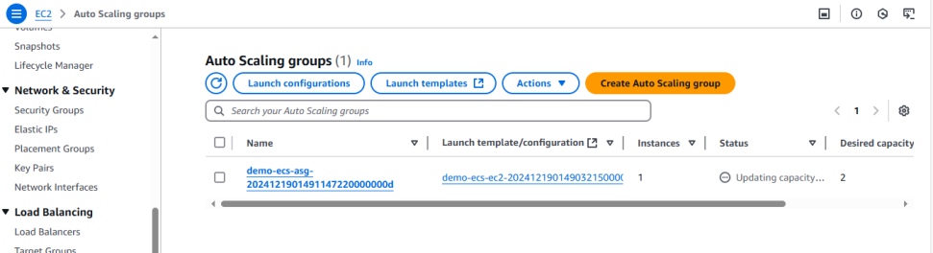
Below is ecs node security group we will see in aws console
# --- ECS ASG ---
resource "aws_autoscaling_group" "ecs" {
name_prefix = "demo-ecs-asg-"
vpc_zone_identifier = aws_subnet.public[*].id
min_size = 2
max_size = 8
health_check_grace_period = 0
health_check_type = "EC2"
protect_from_scale_in = false
launch_template {
id = aws_launch_template.ecs_ec2.id
version = "$Latest"
}
tag {
key = "Name"
value = "demo-ecs-cluster"
propagate_at_launch = true
}
tag {
key = "AmazonECSManaged"
value = ""
propagate_at_launch = true
}
}

Slide 18
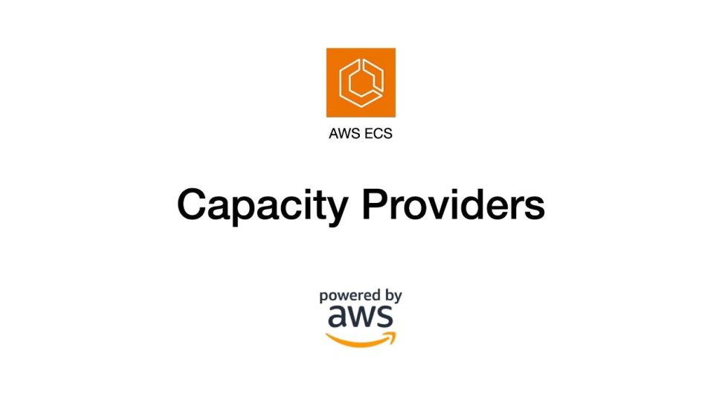
Below is ecs capacity provider we will see in aws console
# --- ECS Capacity Provider ---
resource "aws_ecs_capacity_provider" "main" {
name = "demo-ecs-ec2"
auto_scaling_group_provider {
auto_scaling_group_arn = aws_autoscaling_group.ecs.arn
managed_termination_protection = "DISABLED"
managed_scaling {
maximum_scaling_step_size = 2
minimum_scaling_step_size = 1
status = "ENABLED"
target_capacity = 100
}
}
}
resource "aws_ecs_cluster_capacity_providers" "main" {
cluster_name = aws_ecs_cluster.main.name
capacity_providers = [aws_ecs_capacity_provider.main.name]
default_capacity_provider_strategy {
capacity_provider = aws_ecs_capacity_provider.main.name
base = 1
weight = 100
}
}

Slide 19
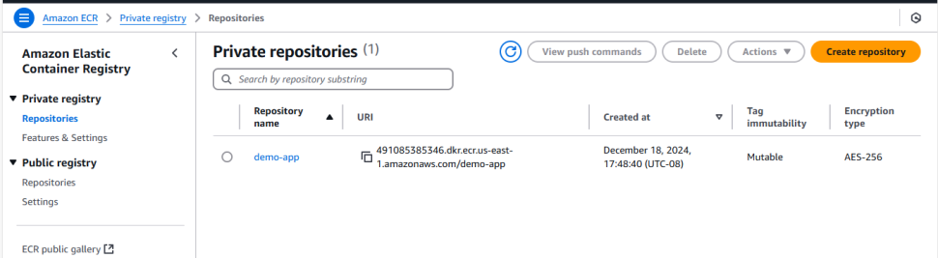
Below is ecr we will see in aws console
# --- ECR ---
resource "aws_ecr_repository" "app" {
name = "demo-app"
image_tag_mutability = "MUTABLE"
force_delete = true
image_scanning_configuration {
scan_on_push = true
}
}
output "demo_app_repo_url" {
value = aws_ecr_repository.app.repository_url
}

Slide 20
Below is ecs task role we will see in aws console
# --- ECS Task Role ---
data "aws_iam_policy_document" "ecs_task_doc" {
statement {
actions = ["sts:AssumeRole"]
effect = "Allow"
principals {
type = "Service"
identifiers = ["ecs-tasks.amazonaws.com"]
}
}
}
resource "aws_iam_role" "ecs_task_role" {
name_prefix = "demo-ecs-task-role"
assume_role_policy = data.aws_iam_policy_document.ecs_task_doc.json
}
resource "aws_iam_role" "ecs_exec_role" {
name_prefix = "demo-ecs-exec-role"
assume_role_policy = data.aws_iam_policy_document.ecs_task_doc.json
}
resource "aws_iam_role_policy_attachment" "ecs_exec_role_policy" {
role = aws_iam_role.ecs_exec_role.name
policy_arn = "arn:aws:iam::aws:policy/service-role/AmazonECSTaskExecutionRolePolicy"
}

Slide 21
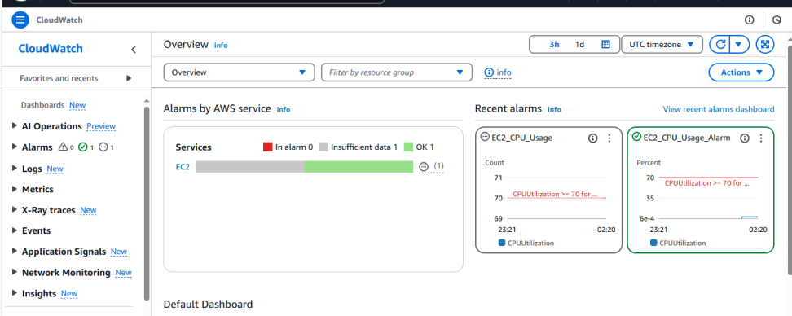
Below is aws cloud watch logs we will see in aws console
# --- Cloud Watch Logs ---
resource "aws_cloudwatch_log_group" "ecs" {
name = "/ecs/demo"
retention_in_days = 14
}

Slide 22
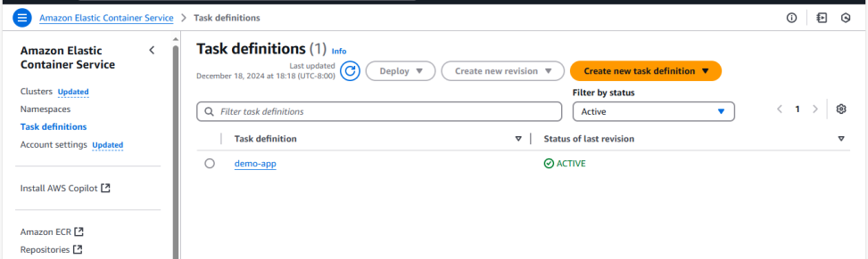
Below is ecs task defination we will see in aws console
# --- ECS Task Definition ---
resource "aws_ecs_task_definition" "app" {
family = "demo-app"
task_role_arn = aws_iam_role.ecs_task_role.arn
execution_role_arn = aws_iam_role.ecs_exec_role.arn
network_mode = "awsvpc"
cpu = 256
memory = 256
container_definitions = jsonencode([{
name = "app",
image = "${aws_ecr_repository.app.repository_url}:latest",
essential = true,
portMappings = [{ containerPort = 80, hostPort = 80 }],
environment = [
{ name = "EXAMPLE", value = "example" }
]
logConfiguration = {
logDriver = "awslogs",
options = {
"awslogs-region" = "us-east-1",
"awslogs-group" = aws_cloudwatch_log_group.ecs.name,
"awslogs-stream-prefix" = "app"
}
},
}])
}

Slide 23
# --- ECS Service --- resource "aws_security_group" "ecs_task" {
name_prefix = "ecs-task-sg-"
description = "Allow all traffic within the VPC"
vpc_id = aws_vpc.main.id
ingress {
from_port = 0
to_port = 0
protocol = "-1"
cidr_blocks = [aws_vpc.main.cidr_block]
}
egress {
from_port = 0
to_port = 0
protocol = "-1"
cidr_blocks = ["0.0.0.0/0"]
}
}
resource "aws_ecs_service" "app" {
name = "app"
cluster = aws_ecs_cluster.main.id
task_definition = aws_ecs_task_definition.app.arn
desired_count = 2 network_configuration {
security_groups = [aws_security_group.ecs_task.id]
subnets = aws_subnet.public[*].id
}
capacity_provider_strategy {
capacity_provider = aws_ecs_capacity_provider.main.name
base = 1
weight = 100
}
ordered_placement_strategy {
type = "spread"
field = "attribute:ecs.availability-zone"
}
lifecycle {
ignore_changes = [desired_count]
}
}

Slide 24
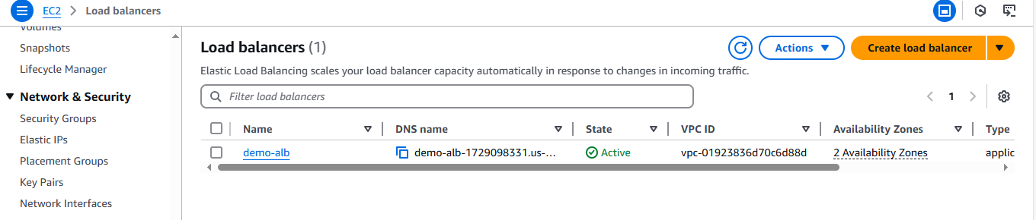
Below is ecs load balancer we will see in aws console
# --- ALB ---
resource "aws_security_group" "http" {
name_prefix = "http-sg-"
description = "Allow all HTTP/HTTPS traffic from public"
vpc_id = aws_vpc.main.id
dynamic "ingress" {
for_each = [80, 443]
content {
protocol = "tcp"
from_port = ingress.value
to_port = ingress.value
cidr_blocks = ["0.0.0.0/0"]
}
}
egress {
protocol = "-1"
from_port = 0
to_port = 0
cidr_blocks = ["0.0.0.0/0"]
}
}
resource "aws_lb" "main" {
name = "demo-alb"
load_balancer_type = "application"
subnets = aws_subnet.public[*].id
security_groups = [aws_security_group.http.id]
}
resource "aws_lb_target_group" "app" {
name_prefix = "app-"
vpc_id = aws_vpc.main.id
protocol = "HTTP"
port = 80
target_type = "ip"
health_check {
enabled = true
path = "/"
port = 80
matcher = 200
interval = 10
timeout = 5
healthy_threshold = 2
unhealthy_threshold = 3
}
}
resource "aws_lb_listener" "http" {
load_balancer_arn = aws_lb.main.id
port = 80
protocol = "HTTP"
default_action {
type = "forward"
target_group_arn = aws_lb_target_group.app.id
}
}

Slide 25


